Slide 1
Unit V Design Principles and Pattern

Slide 2
What Are Design Patterns?
Design patterns are:
Schematic descriptions of design solutions to recurring problems in software design, and
Reusable , but don’t have to be implemented in the same way.
That is, describe:
Design problems that occur repeatedly, and
Core solutions to those problems.

Slide 3
Introduction
Patterns occur in ever facet of software development, at every phase, and at every level of detail
The ability to recognize patterns allow us to classify problem solutions in terms of problems and contexts, providing a common vocabulary for software developers to use

Slide 4
What are Patterns?
Christopher Alexander says “Each pattern describes a problem which occurs over and over again in our environment, and then describes the core of the solution to that problem in such a way that you can use this solution a million times over, without ever doing it the same way twice”

Slide 5
Usage of Design Pattern
Common platform for developers
Best Practices

Slide 6
In general, a pattern has the following attributes:
The Name: the pattern name is a handle we can use to refer to the pattern, thus describing the problem, solution, and consequences in a word or two
The Problem: Describes when to apply the pattern, this is broken into both a description of the problem and its context.
The Solution: describes the elements that make up the design, their relationships, responsibilities, collaborations. Often includes some example code or pseudo-code, but doesn’t describe a particular implementation
The Consequences: describes the results and trade-offs of using the pattern. All design is compromise, and make patterns provide both benefits and drawbacks that must be balanced

Slide 7
The Need for Patterns
Designing object-oriented software is hard
Designing reusable object-oriented software is even harder
Have to find pertinent objects, factor them into classes at the right granularity, establish relationships between them, design a flexible interface
Design should be specific enough for the problem at hand, but general enough to address future problems (scale up or down)

Slide 8
Purpose of Patterns
The purpose of patterns then can be generalized as providing the following:
Giving a vocabulary to a problem, context, solution, consequences set
Cataloging designs that have proved successful in past systems and formalizing their elements, relationships, interactions, etc.
Provide enough information about trade-offs and consequences to allow an intelligent design decision to be made about applying a given solution

Slide 9
GRASP
General Responsibility Assignment Software Patterns
The “patterns” provide a representation of nine basic principles that form a foundation for designing object oriented systems
. They describe fundamental principals of object design and responsibility assignment, expressed as pattern

Slide 10
Creator
Information Expert
Controller
High Cohesion
Indirection
Low Coupling
Polymorphism
Protected Variations
Pure Fabrication

Slide 11
GRASP or General Responsibility Assignment Software Principles help guide object-oriented design by clearly outlining WHO does WHAT.
Which object or class is responsible for what action or role?
GRASP also helps us define how classes work with one another.
The key point of GRASP is to have efficient, clean, understandable code.

Slide 12
Responsibility:
Responsibility can be: – accomplished by a single object. – or a group of object collaboratively accomplish a responsibility.
GRASP helps us in deciding which responsibility should be assigned to which object/class.
Identify the objects and responsibilities from the problem domain, and also identify how objects interact with each other.
Define blue print for those objects – i.e. class with methods implementing those responsibilities

Slide 13
Responsibilities of an Object include two types : Knowing and Doing
Doing responsibilities of an object include:
•Doing something itself, such as creating an object or doing a calculation
•Initiating action in other objects
•Controlling and coordinating activities in other objects
Knowing responsibilities of an object include: •Knowing about private encapsulated data
•Knowing about related objects
•Knowing about things it can derive or calculate

Slide 14
Responsibilities are an abstraction – methods fulfill responsibilities
Responsibilities are implemented by means of methods that either act alone or collaborate with other methods and objects.

Slide 15
Creator
Name: Creator
Problem: Who creates an object A?
Solution: Assign class B the responsibility to create an instance of class A if one of these is true
B “contains” or completely aggregates A
B records A
B closely uses A
B has the initializing data for A

Slide 16
Example for Creator
Consider VideoStore and Video in that store.
VideoStore has an aggregation association
with Video. I.e, VideoStore is the container and
the Video is the contained object.
So, we can instantiate video object in
VideoStore class

Slide 17
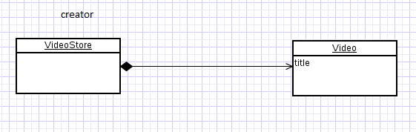
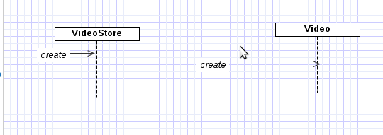

Slide 18
Example: (from POS system) Who should be responsible for creating a new SalesLineItem instance?
Start with domain model:

Slide 21
Creator
Example: (from POS system) Who should be responsible for creating a new SalesLineItem instance?
Since a Sale contains SalesLineItem objects it should be responsible according to the Creator pattern
Note: there is a related design pattern called Factory for more complex creation situations

Slide 22
Information Expert
Problem: What is a general principle of assigning responsibilities to objects?
• Solution: Assign a responsibility to the information expert—the class that has the information necessary to fulfill the responsibility.
Example: (from POS system) Who should be responsible for knowing the grand total of a sale

Slide 23
Given an object o, which responsibilities can
be assigned to o?
Expert principle says – assign those
responsibilities to o for which o has the
information to fulfill that responsibility.
They have all the information needed to
perform operations, or in some cases they
collaborate with others to fulfill their
responsibilities.

Slide 24
Example for Expert
Assume we need to get all the videos of a
VideoStore.
Since VideoStore knows about all the videos,
we can assign this responsibility of giving all
the videos can be assigned to VideoStore
class.
VideoStore is the information expert.

Slide 25
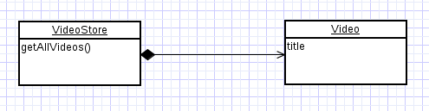
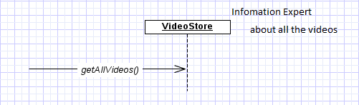

Slide 26
Information Expert
Example: (from POS system) Who should be responsible for knowing the grand total of a sale?
Start with domain model and look for associations with Sale
What information is necessary to calculate grand total and which objects have the information?

Slide 28
Information Expert
Example (cont.):
From domain model:
“Sale Contains SalesLineItems” so it has the information necessary for total . . .

Slide 30
Information Expert
Example (cont.):
How is line item subtotal determined?
quantity – an attribute of SalesLineItem
price – stored in ProductDescription . . .

Slide 32
Information Expert
Example (cont.): Who should be responsible for knowing the grand total of a sale?
Summary of responsibilities:
Design Class | Responsibility
Sale | knows sale total
SalesLineItem | knows line item subtotal
ProductDescription | knows product price

Slide 33
Information Expert
Information Expert => “objects do things related to the information they have”
Information necessary may be spread across several classes => objects interact via messages

Slide 34
Information Expert
Information Expert is not the only pattern so just because an object has information necessary doesn’t mean it will have responsibility for action related to the information
Example: who is responsible for saving a sale in a database
Problems if it is given to Sale (will violate other principles: cohesion, coupling)

Slide 35
Example for Expert
Assume we need to get all the videos of a
VideoStore.
Since VideoStore knows about all the videos,
we can assign this responsibility of giving all
the videos can be assigned to VideoStore
class.
VideoStore is the information expert.

Slide 36
LMS-classes
Librarian
Name : String
id : int
pass : string
Book
Uses
Id
Author
Name
Issuebook()
Returnbook()
calculateFine()
Searchbook()

Slide 37
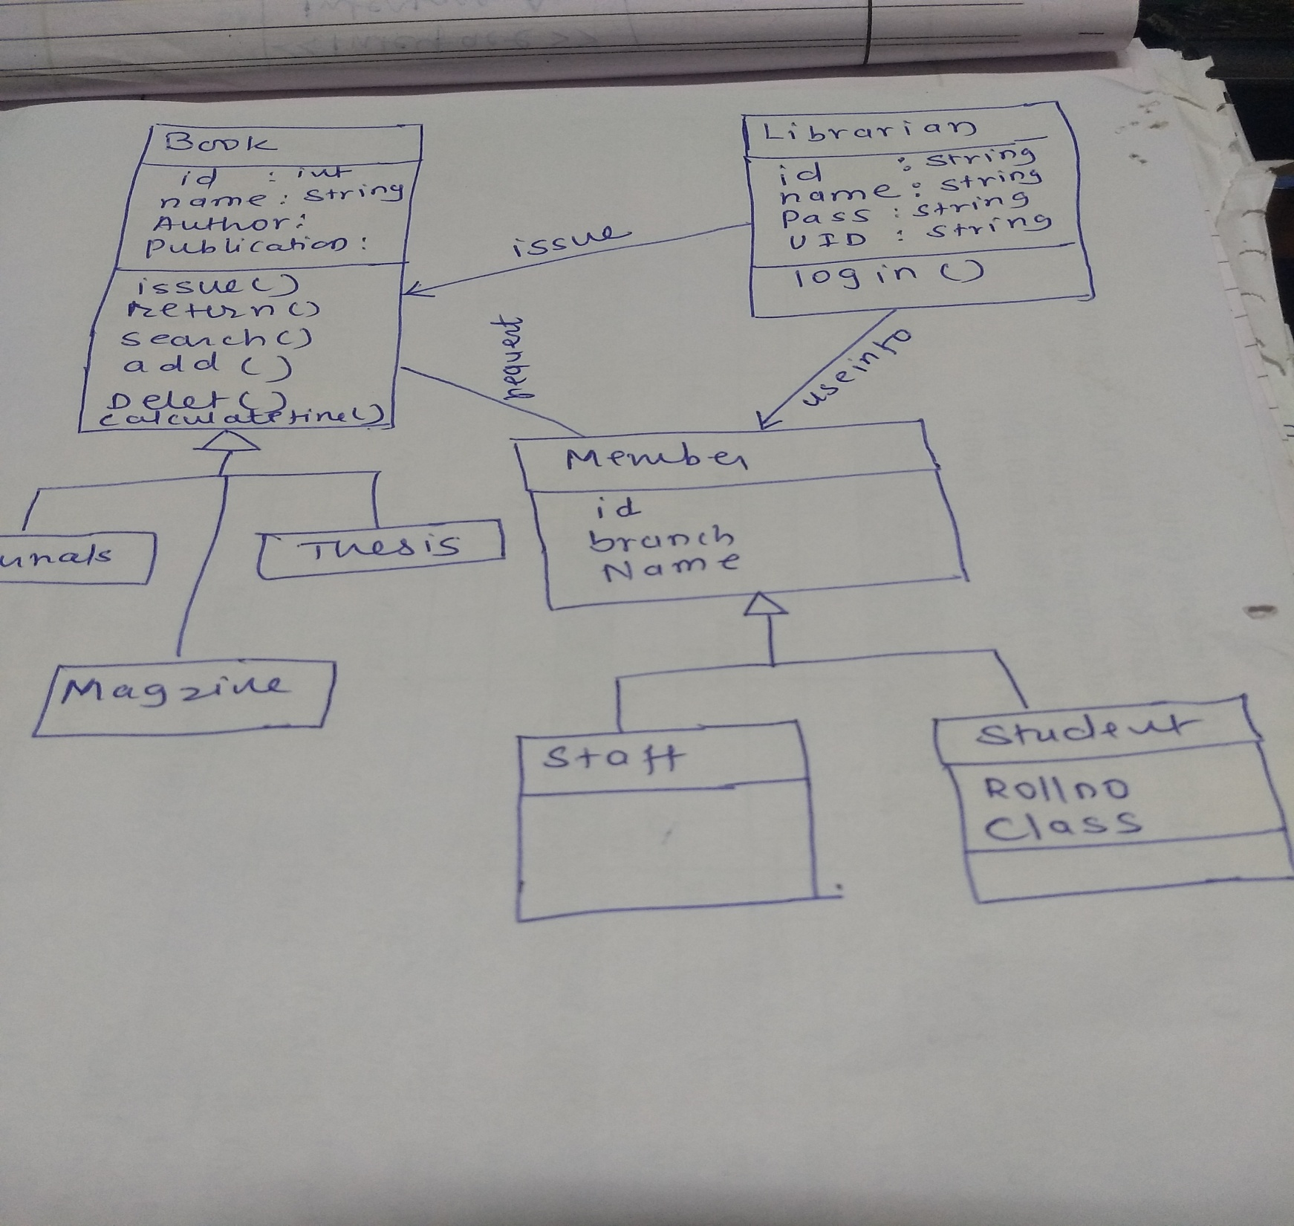

Slide 38
Low Coupling
Problem: How to support low dependency, low change
impact, and increased reuse?
Solution: Assign a responsibility so that coupling
remains low.
Coupling – a measure of how strongly one element is connected to, has knowledge of, or relies on other elements

Slide 39
A class with high coupling relies on many other classes – leads to problems:
Changes in related classes force local changes
Harder to understand in isolation
Harder to reuse

Slide 40
Example (from POS system):
Consider Payment, Register, Sale
Need to create a Payment and associate it with a Sale, who is responsible?
Creator => since a Register “records” a Payment it should have this responsibility
Register creates Payment p then sends p to a Sale => coupling of Register class to Payment class

Slide 41
Example (from POS system):
Consider Payment, Register, Sale
Need to create a Payment and associate it with a Sale, who is responsible?
Alternate approach:
Register requests Sale to create the Payment

Slide 43
Consider coupling in two approaches:
In both cases a Sale needs to know about a Payment
However a Register needs to know about a Payment in first but not in second
Second approach has lower coupling

Slide 45
Low coupling is an evaluative principle, i.e. keep it in mind when evaluating designs
Examples of coupling in Java (think “dependencies”):
TypeX has an attribute of TypeY
TypeX calls on services of a TypeY object
TypeX has a method that references an instance of TypeY
TypeX is a subclass of TypeY
TypeY is an interface and TypeX implements the interface
Note: subclassing => high coupling

Slide 46
High Cohesion
Problem: How to keep complexity manageable?
Solution: Assign the responsibility so that cohesion remains high.
Cohesion – a measure of how strongly related and focused the responsibilities of an element (class, subsystem, etc.) are

Slide 47
Problems from low cohesion (does many unrelated things or does too much work):
-Hard to understand/comprehend
-Hard to reuse
-Hard to maintain
-Delicate – easily affected by change

Slide 48
How are the operations of any element are functionally related?
Related responsibilities in to one manageable unit.
Prefer high cohesion
Clearly defines the purpose of the element
Benefits
– Easily understandable and maintainable.
– Code reuse
– Low coupling

Slide 49
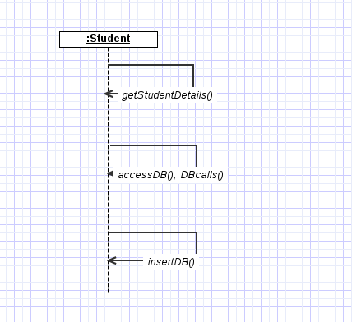
Example for low cohesion

Slide 50
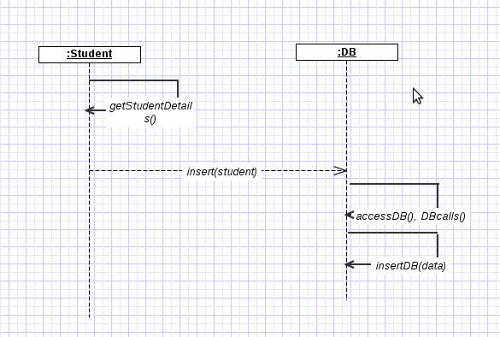
Example for High Cohesion

Slide 51
High Cohesion
Example: (from POS system) Who should be responsible for creating a Payment instance and associate it with a Sale?
Register creates a Payment p then sends addPayment(p) message to the Sale

Slide 52
High Cohesion
Register is taking on responsibility for system operation makePayment()
In isolation no problem
But if we start assigning additional system operations to Register then will violate high cohesion

Slide 53
High Cohesion
Example: (from POS system) Who should be responsible for creating a Payment instance and associate it with a Sale?
Register delegates Payment creation to the Sale

Slide 54
High Cohesion
This second approach will lead to higher cohesion for Register class.
Note: this design supports both low coupling and high cohesion
High cohesion, like low coupling, is an evaluative principle

Slide 55
High Cohesion
Consider:
Very low cohesion – a class is responsible for many things in different functional areas
Low cohesion – a class has sole responsibility for a complex task in one functional area
Moderate cohesion – a class has lightweight and sole responsibilities in a few different areas that are logically related to the class concept but not to each other
High cohesion – a class has moderate responsibilities in one functional area and collaborates with other classes to fulfill tasks

Slide 56
High Cohesion
Typically high cohesion => few methods with highly related functionality
Benefits of high cohesion:
Easy to maintain
Easy to understand
Easy to reuse

Slide 57
Controller
Problem: Who should be responsible for handling an input system event?
Solution: Assign the responsibility for receiving and/or handling a system event to one of following choices:
Object that represents overall system, device or subsystem (façade controller)
Object that represents a use case scenario within which the system event occurs (a <UseCase>Handler)

Slide 58
Controller
Input system event – event generated by an external actor associated with a system operation
Controller – a non-UI object responsible for receiving or handling a system event

Slide 59
Deals with how to delegate the request from the UI layer
objects to domain layer objects.
● when a request comes from UI layer object, Controller pattern
helps us in determining what is that first object that receive the
message from the UI layer objects.
● This object is called controller object which receives request
from UI layer object and then controls/coordinates with other
object of the domain layer to fulfill the request.
● It delegates the work to other class and coordinates the
overall activity.

Slide 60
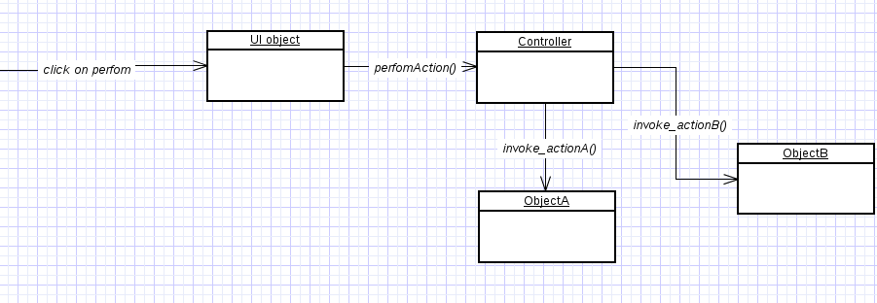

Slide 61
Controller
During analysis can assign system operations to a class System
That doesn’t mean there will be a System class at time of design
During design a controller class is given responsibility for system operations
A façade controller in fig.

Slide 63
Controller
Controller is a façade into domain layer from interface layer
Often use same controller class for all system events of one use case so that one can maintain state information, e.g. events must occur in a certain order
Normally controller coordinates activity but delegates work to other objects rather than doing work itself

Slide 64
Controller
Façade controller representing overall system – use when there aren’t many system events
Use case controllers – different controller for each use case

Slide 68
Controller
Bloated controller
Single class receiving all system events and there are many of them
Controller performs many tasks rather than delegating them
Controller has many attributes and maintains significant information about system which should have been distributed among other objects

Slide 69
Fig. 17.24

Slide 70
Bloated Controllers
● Controller class is called bloated, if
– The class is overloaded with too many
responsibilities.
Solution – Add more controllers
– Controller class also performing many tasks
instead of delegating to other class.
Solution – controller class has to delegate things
to others.

Slide 71
Polymorphism
Problem: How to handle alternatives based on type? How to create pluggable software components?
Solution: When related alternatives or behaviors vary by type (class), assign responsibility
for the behavior—using polymorphic operations—to the types for which the
behavior varies.

Slide 72
How to handle related but varying elements
based on element type?
● Polymorphism guides us in deciding which
object is responsible for handling those
varying elements.
● Benefits: handling new variations will become
easy.

Slide 73
Example for Polymorphism
the getArea() varies by the type of shape, so we assign that responsibility to the subclasses.
By sending message to the Shape object, a call will be made to the corresponding sub class object – Circle or Triangle

Slide 74
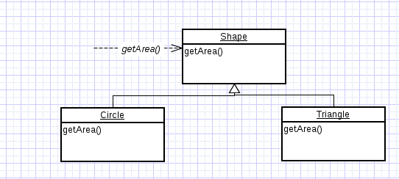

Slide 75
Example In the NextGen POS application,
there are multiple external third-party tax calculators
that must be supported (such as Tax-Master and Good-As-Gold Tax-Pro);
the system needs to be able to integrate with different ones.
Each tax calculator has a different interface, and so there is similar but varying behavior to adapt to each of these external fixed interfaces or APIs.
One product may support a raw TCP socket protocol, another may offer a SOAP interface, and a third
may offer a Java RMI interface.

Slide 76
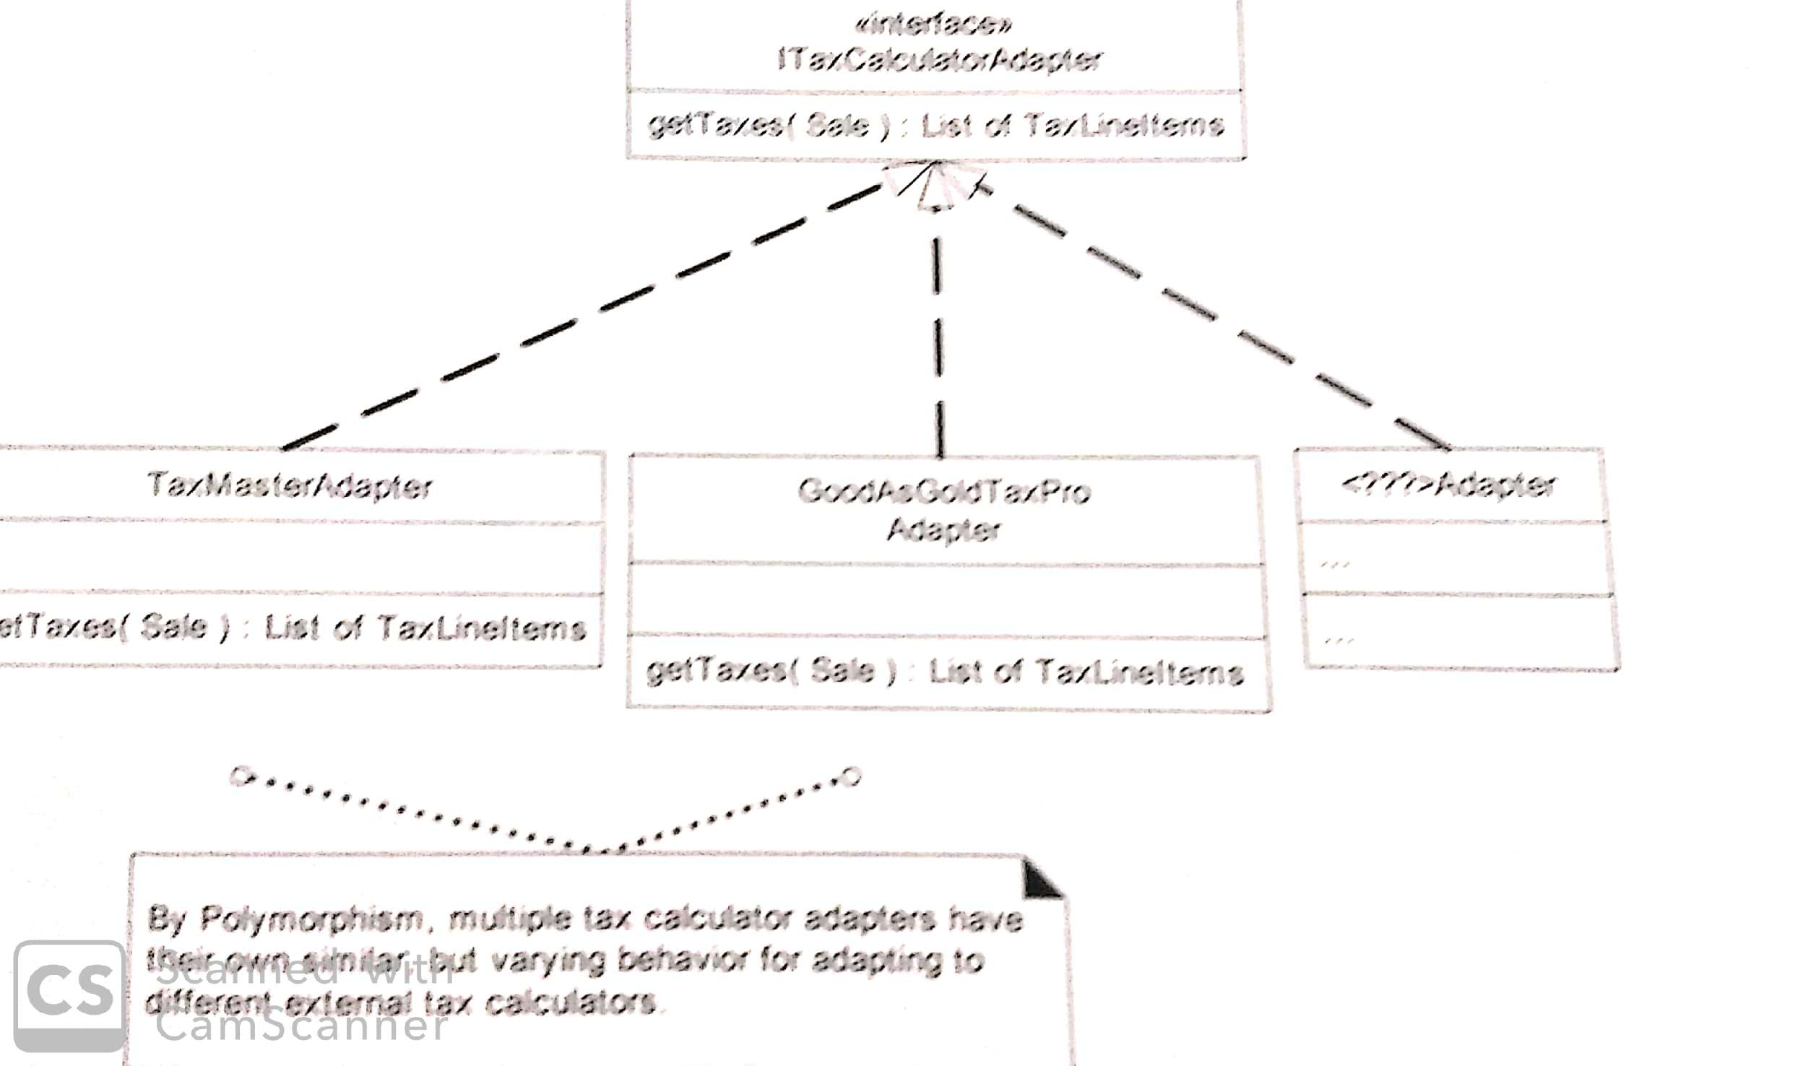

Slide 77
Pure Fabrication
Problem: Sometimes, during design, responsibilities need to be assigned that are not naturally attributable to any of the conceptual classes.
Solution: Create an artificial class that does not represents anything in the problem domain.
• Note: Most of the GoF patterns involve fabricating new classes--e.g. observer, adapter, abstract factory, etc.

Slide 78
Assign a highly cohesive set of responsibilities to an artificial or convenience class that does not represent a problem domain concept—something made up, to support high cohesion, low coupling, and reuse.

Slide 79
Fabricated class/ artificial class – assign set of
related responsibilities that doesn't represent
any domain object.
● Provides a highly cohesive set of activities.
● Behavioral decomposed – implements some
algorithm.
● Examples: Adapter, Strategy
● Benefits: High cohesion, low coupling and can
reuse this class.

Slide 80
Example
● Suppose Shape class, if we must store the shape data in a database.
● If we put this responsibility in Shape class, there will be many database related operations thus making Shape incohesive.
● So, create a fabricated class DBStore which is
responsible to perform all database operations.
● Similarly logInterface which is responsible for logging information

Slide 81
The task requires a relatively large number of supporting database-oriented
operations, none related to the concept of sale-ness, so the Sale class
becomes incohesive.
• The Sale class has to be coupled to the relational database interface (such as
JDBC in Java technologies), so its coupling goes up. And the coupling is not
even to another domain object, but to a particular kind of database
interface.
• Saving objects in a relational database is a very general task for which
many classes need support. Placing these responsibilities in the Sale class
suggests there is going to be poor reuse or lots of duplication in other classes
that do the same thing.

Slide 82
This Pure Fabrication solves the following design problems:
• The Sale remains well-designed, with high cohesion and low coupling.
• The PersistentStorage class is itself relatively cohesive, having the sole pur pose of storing or inserting objects in a persistent storage medium.
• The PersistentStorage class is a very generic and reusable object.

Slide 83
Indirection
Solution :
Assign the responsibility to an intermediate object to mediate between other components or services so that they are not directly coupled.
The intermediary creates an indirection between the other components.
Problem:
Where to assign a responsibility, to avoid direct coupling between two (or more) things? How to de-couple objects so that low coupling is supported and reuse potential remains higher?

Slide 84
Indirection
● How can we avoid a direct coupling between
two or more elements.
● Indirection introduces an intermediate unit to
communicate between the other units, so that
the other units are not directly coupled.
● Benefits: low coupling
● Example: Adapter, Facade, Obserever

Slide 85
Examples TaxCalculatorAdapter
These objects act as intermediaries to the external tax calculators. Via polymorphism,
they provide a consistent interface to the inner objects and hide the variations in the external APIs. By adding a level of indirection and adding polymorphism, the adapter objects protect the inner design against variations in the external interfaces .

Slide 86
Protected Variation
Solution :Identify points of predicted variation or instability; assign responsibilities to create a stable interface around them.
Note: The term "interface" is used in the broadest sense of an access view;
Problem :How to design objects, subsystems, and systems so that the variations or instability
in these elements does not have an undesirable impact on other elements?

Slide 87
Protected Variation
How to avoid impact of variations of some
elements on the other elements.
● It provides a well defined interface so that the
there will be no affect on other units.
● Provides flexibility and protection from
variations.
● Provides more structured design.
● Example: polymorphism, data encapsulation,
interfaces

Slide 88
Example
For example, the prior external tax calculator problem and its solution with Polymorphism illustrate Protected Variations. The point of instability or variation is the different interfaces or APIs of external tax calculators.
The POS system needs to be able to integrate with many existing tax calculator systems, and also with future third-party calculators not yet in existence.
By adding a level of indirection, an interface, and using polymorphism with various ITaxCalculatorAdapter implementations, protection within the system from variations in external APIs is achieved. Internal objects collaborate with a stable interface; the various adapter implementations hide the variations to the
external systems.

Slide 89
What is Gang of Four (GOF)?
In 1995, four authors Erich Gamma, Richard Helm, Ralph Johnson and John Vlissides published a book titled Design Patterns - Elements of Reusable Object-Oriented Software which initiated the concept of Design Pattern in Software development.
These authors are collectively known as Gang of Four (GOF).
According to these authors design patterns are primarily based on the following principles of object orientated design.
Program to an interface not an implementation
Favor object composition over inheritance

Slide 90
OO CONCEPTS
Normal Class: This is a normal class
Abstract Class: These cannot be instantiated directly. They may provide partial implementations and exists solely for the purpose of inheritance.
Interfaces: Defines a contract. Concrete implementations needs to implement each property and method as per contract.

Slide 91
Employee
Developer
Associate Developer
Lead Developer
Manager
Product Manager
Project Manager

Slide 92
If a particular class is a entity which is not required to be instantiated by the application directly, go for Abstract Class
Employee can be abstract class

Slide 93
If a particular class contains any default behavior, go for Abstract Class
If every concrete class has its own implementation, go for Interfaces
Work – Management, Programming

Slide 94
Types and Interfaces
A type is a name used to describe a particular interface (this does not necessarily have to refer to a concrete class)
Objects declare a set of operations that it supports, each of these operations has a particular signature, that is, it’s name, the objects it takes as parameters and its return type. The set of all operations that an object supports defines an interface to that object

Slide 95
Inheritance vs. Composition
There are two common techniques for facilitating object reuse in systems: class inheritance and object composition. Object composition refers to assembling (composing) multiple objects together to get more complex functionality
Each has their own advantages and disadvantages, but in general, one of the tenets of object-oriented programming is to Favor object composition over class inheritence

Slide 96
Why Composition is Better
Usually, inheritance is defined at compile-time, meaning you can’t change implementations inherited from parent classes at run-time
Parents classes usually define at least part of their subclasses’ physical representation. For this reason, it’s often said that “inheritance breaks encapsulation”. Normally, the subclass is implemented in terms of the parent’s implementation, leading to a cascade of changes should a parent class be modified
Composition is defined at run-time by objects acquiring references to other objects. Composition requires objects to respect interfaces, which require objects to be designed so they don’t stop you from using an object with many others

Slide 97
More on Composition
Because objects are accessed solely through their interfaces, we do not break encapsulation, and any object may be swapped out for another so long as their type (that is, their interface) remains the same
Composition also allows for each class to be kept isolated, small, and well encapsulated. Inheritance hierarchies will tend to remain small and will be less likely to grow into unmanageable and unmaintainable monsters

Slide 98
Types of Patterns
There are generally 3 types of patterns:
Architectural Patterns
Design Patterns
Idioms(Language Specific)

Slide 99
Architectural Patterns
Architectural Patterns express a fundamental structural organization for software systems
It provides a set of predefined sub-systems, specifies their responsibilities, and includes rules for establishing relationships between them

Slide 100
Architectural Patterns Examples
3-tier database systems (Database, Intermediate DB Layer, User-Application)
Client/Server
Component (Module) -Based Software Systems
Feedback Systems
Event-Driven Systems

Slide 101
Design Patterns
Popularized by the 1995 book Design Patterns: Elements of Reusable Object-Oriented Software written by Erich Gamma, Richard Helm, Ralph Johnson, and John Vlissides (also called the Gang of Four Book or GOF)
Their work largely based on Alexander’s The Timeless Way of Building

Slide 102
Categories of Design Patterns
Design Patterns - Elements of Reusable Object-Oriented Software
there are 23 design patterns which can be classified in three categories: Creational, Structural and Behavioral patterns

Slide 103
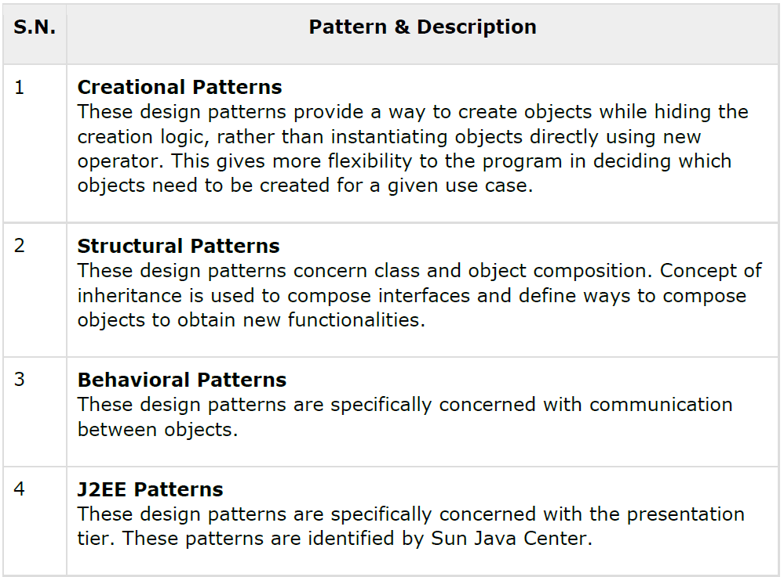

Slide 104
Let’s understand the purpose
Creational
Structural
Behavioral
Concerns the process of object creation
Deal with the composition of classes /objects
Characterize the ways in which classes/objects interact and distribute responsibility

Slide 105
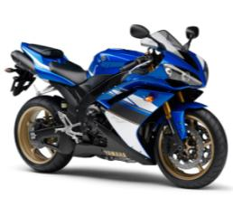
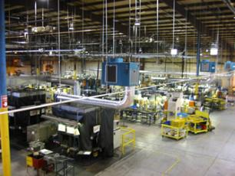
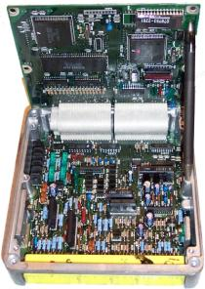


Let’s understand the purpose
Final Product
Creational Patterns
Behavioral Patterns
Structural Patterns
+

Slide 106
Design Pattern Catalog
Creational Patterns
Abstract Factory
Builder
Factory Method
Prototype
Singleton
Structural Patterns
Adapter
Bridge
Composite
Container
Decorator
Façade
Flyweight
Proxy
Behavioral Patterns
Chain of Responsibility
Command
Interpreter
Iterator
Mediator
Memento
Multiple Dispatch
Observer
State
Strategy
Template Method
Visitor

Slide 107
Design pattern Documentation
Pattern name Classification
Intent-(What does the design pattern do?)
Also know as
Motivation
Applicability
Structure
Participants
Collaboration
Consequences – ( What are trade-offs and result of using the pattern)
Implementation
Sample code
Know Uses-Examples of pattern found in real systems.
Related patterns

Slide 108
Strategy Pattern
Definition: Define a family of algorithms, encapsulate each one, and make them interchangeable.
In Strategy pattern, a class behavior or its algorithm can be changed at run time. This type of design pattern comes under behavior pattern.
In Strategy pattern, we create objects which represent various strategies and a context object whose behavior varies as per its strategy object. The strategy object changes the executing algorithm of the context object.

Slide 109
Strategy Pattern
Define strategies for a performing a behavior and change them dynamically as per requirement
This lets the algorithm vary independently from clients that uses it
It is about choice, which affects outcomes
One behavior and Multiple strategies

Slide 110
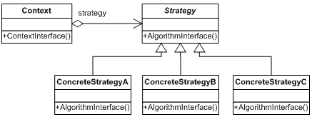

Slide 111
Participants
The classes and objects participating in this pattern are:
Strategy (SortStrategy)
-declares an interface common to all supported algorithms. Context uses this interface to call the algorithm defined by a ConcreteStrategy
ConcreteStrategy (QuickSort, ShellSort, MergeSort)
-implements the algorithm using the Strategy interface
Context (SortedList)
-is configured with a ConcreteStrategy object
-maintains a reference to a Strategy object
-may define an interface that lets Strategy access its data.

Slide 112
Implementation
We are going to create a Strategy interface defining an action and concrete strategy classes implementing the Strategy interface. Context is a class which uses a Strategy.
StrategyPatternDemo, our demo class, will use Context and strategy objects to demonstrate change in Context behaviour based on strategy it deploys or uses.

Slide 113
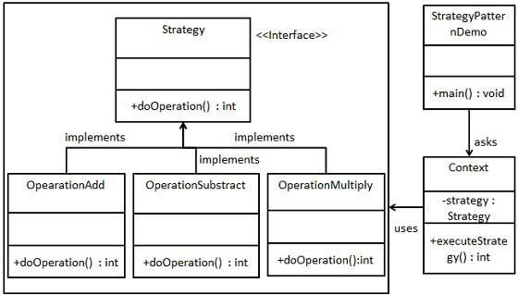

Slide 114
Step 1 Create an interface.
Strategy.java
public interface Strategy {
public int doOperation(int num1, int num2);
}

Slide 115
Step 2 Create concrete classes implementing the same interface
OperationAdd.java
public class OperationAdd implements Strategy{
@Override
public int doOperation(int num1, int num2) {
return num1 + num2;
}
}

Slide 116
OperationSubstract.java
public class OperationSubstract implements Strategy{
@Override
public int doOperation(int num1, int num2) {
return num1 - num2;
}
}

Slide 117
OperationMultiply.java
public class OperationMultiply implements Strategy{
@Override
public int doOperation(int num1, int num2) {
return num1 * num2;
}
}

Slide 118
. Step 3 Create Context Class
Context.java
public class Context {
private Strategy strategy;
public Context(Strategy strategy){
this.strategy = strategy;
}
public int executeStrategy(int num1, int num2){
return strategy.doOperation(num1, num2);
}
}

Slide 119
Step 4 Use the Context to see change in behavior when it changes its Strategy.
StrategyPatternDemo.java
public class StrategyPatternDemo {
public static void main(String[] args) {
Context context = new Context(new OperationAdd());
System.out.println("10 + 5 = " + context.executeStrategy(10, 5));
context = new Context(new OperationSubstract());
System.out.println("10 - 5 = " + context.executeStrategy(10, 5));
context = new Context(new OperationMultiply());
System.out.println("10 * 5 = " + context.executeStrategy(10, 5));
}
}

Slide 120
Step 5 Verify the output.
10 + 5 = 15
10 - 5 = 5
10 * 5 = 50

Slide 121
State Pattern
Definition: Allow an object to alter its behavior when its internal state changes. The object will appear to change its class.
In State pattern, a class behavior changes based on its state. This type of design pattern comes under behavior pattern.
In State pattern, we create objects which represent various states and a context object whose behavior varies as its state object changes.

Slide 122
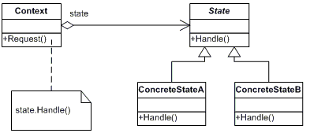

Slide 123
Participants
The classes and objects participating in this pattern are:
Context (Account)
-defines the interface of interest to clients
-maintains an instance of a ConcreteState subclass that -defines the current state.
State (State)
-defines an interface for encapsulating the behavior associated with a particular state of the Context.
Concrete State (RedState, SilverState, GoldState)
each subclass implements a behavior associated with a state of Context

Slide 124
General Description
A type of Behavioral pattern.
Allows an object to alter its behavior when its internal state changes. The object will appear to change its class.
Uses Polymorphism to define different behaviors for different states of an object.

Slide 125
When to use STATE pattern ?
State pattern is useful when there is an object that can be in one of several states, with different behavior in each state.
To simplify operations that have large conditional statements that depend on the object’s state.

Slide 126
Example
water
StateOfWater
state variable
increaseTemp()
decreaseTemp()
increaseTemp()
decreaseTemp()
WaterVapor
LiquidWater
Ice
Client
increaseTemp()
increaseTemp()
decreaseTemp()
increaseTemp()
decreaseTemp()
increaseTemp()
decreaseTemp()

Slide 127
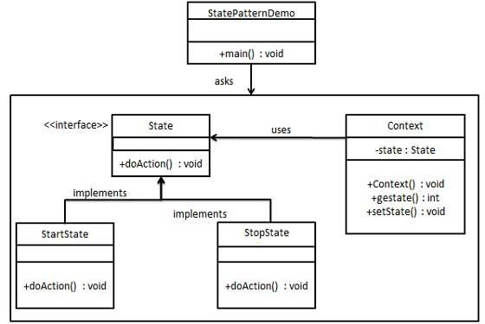
Implementation
We are going to create a State interface defining an action and concrete state classes implementing the State interface. Context is a class which carries a State.
StatePatternDemo, our demo class, will use Context and state objects to demonstrate change in Context behavior based on type of state it is in.

Slide 128
Step 1 Create an interface.
State.java
public interface State {
public void doAction(Context context);
}

Slide 129
Step 2 Create concrete classes implementing the same interface.
StartState.java
public class StartState implements State {
public void doAction(Context context) {
System.out.println("Player is in start state");
context.setState(this);
}
public String toString(){
return "Start State";
}
}

Slide 130
StopState.java
public class StopState implements State {
public void doAction(Context context) {
System.out.println("Player is in stop state");
context.setState(this);
}
public String toString(){
return "Stop State";
}
}

Slide 131
Step 3 Create Context Class.
Context.java
public class Context {
private State state;
public Context(){
state = null;
}
public void setState(State state){
this.state = state;
}
public State getState(){
return state;
}
}

Slide 132
Step 4 Use the Context to see change in behavior when State changes.
StatePatternDemo.java
public class StatePatternDemo {
public static void main(String[] args) {
Context context = new Context();
StartState startState = new StartState();
startState.doAction(context);
System.out.println(context.getState().toString());
StopState stopState = new StopState(); 103
stopState.doAction(context);
System.out.println(context.getState().toString());
}
}

Slide 133
Step 5 Verify the output.
Player is in start state
Start State
Player is in stop state
Stop State

Slide 134
Adapter Pattern
Adapter pattern works as a bridge between two incompatible interfaces.
This type of design pattern comes under structural pattern as this pattern combines the capability of two independent interfaces.
This pattern involves a single class which is responsible to join functionalities of independent or incompatible interfaces.
A real life example could be a case of card reader which acts as an adapter between memory card and a laptop. You plugin the memory card into card reader and card reader into the laptop so that memory card can be read via laptop.

Slide 135
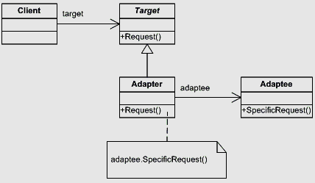
Adapter Pattern

Slide 136
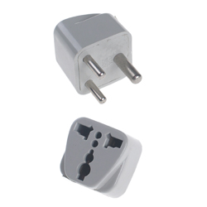

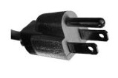
Adapter Pattern
Convert the interface of a class into another interface clients expect
Lets classes work together that couldn’t work otherwise
Works good for making compliance
Legacy
Component
Application
Framework
Adapter

Slide 137
Implementation
We have a MediaPlayer interface and a concrete class AudioPlayer implementing interface. AudioPlayer can play mp3 format audio files by default.
We are having another interface AdvancedMediaPlayer and concrete classes implementing the AdvancedMediaPlayer interface. These classes can play vlc and mp4 format files.
We want to make AudioPlayer to play other formats as well. To attain this, we have created an adapter class MediaAdapter which implements the MediaPlayer interface and uses AdvancedMediaPlayer objects to play the required format.
AudioPlayer uses the adapter class MediaAdapter passing it the desired audio type without knowing the actual class which can play the desired format. AdapterPatternDemo, our demo class, will use AudioPlayer class to play various formats.

Slide 138
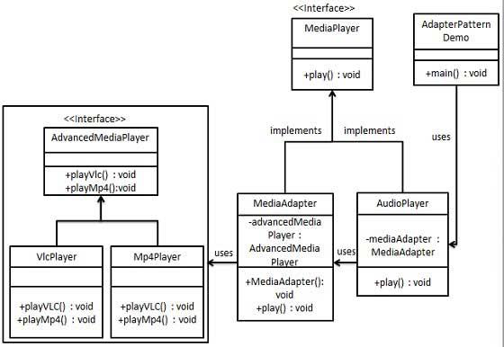

Slide 139
Step 1 Create interfaces for Media Player and Advanced Media Player.
MediaPlayer.java
public interface MediaPlayer {
public void play(String audioType, String fileName);
}
AdvancedMediaPlayer.java
public interface AdvancedMediaPlayer {
public void playVlc(String fileName);
public void playMp4(String fileName);
}

Slide 140
Step 2 Create concrete classes implementing the AdvancedMediaPlayer interface.
VlcPlayer.java
public class VlcPlayer implements AdvancedMediaPlayer{
@Override
public void playVlc(String fileName) {
System.out.println("Playing vlc file. Name: "+ fileName);
}
@Override
public void playMp4(String fileName) {
//do nothing
}
}

Slide 141
Mp4Player.java
public class Mp4Player implements AdvancedMediaPlayer{
@Override
public void playVlc(String fileName) {
//do nothing
}
@Override
public void playMp4(String fileName) {
System.out.println("Playing mp4 file. Name: "+ fileName);
}
}

Slide 142
Step 3 Create adapter class implementing the MediaPlayer interface.
MediaAdapter.java
public class MediaAdapter implements MediaPlayer {
AdvancedMediaPlayer advancedMusicPlayer;
public MediaAdapter(String audioType){
if(audioType.equalsIgnoreCase("vlc") ){
advancedMusicPlayer = new VlcPlayer();
} else if (audioType.equalsIgnoreCase("mp4")){
advancedMusicPlayer = new Mp4Player();
}
}
@Override
public void play(String audioType, String fileName) {
if(audioType.equalsIgnoreCase("vlc")){
advancedMusicPlayer.playVlc(fileName);
}else if(audioType.equalsIgnoreCase("mp4")){
advancedMusicPlayer.playMp4(fileName);
} } }

Slide 143
Step 4 Create concrete class implementing the MediaPlayer interface.
AudioPlayer.java
public class AudioPlayer implements MediaPlayer {
MediaAdapter mediaAdapter;
@Override
public void play(String audioType, String fileName) {
//inbuilt support to play mp3 music files
if(audioType.equalsIgnoreCase("mp3")){
System.out.println("Playing mp3 file. Name: "+ fileName);
}
Continued…

Slide 144
//mediaAdapter is providing support to play other file formats
else if(audioType.equalsIgnoreCase("vlc") || audioType.equalsIgnoreCase("mp4")){
mediaAdapter = new MediaAdapter(audioType);
mediaAdapter.play(audioType, fileName);
}
else{
System.out.println("Invalid media. "+ audioType + " format not supported");
}
}
}

Slide 145
Step 5 Use the AudioPlayer to play different types of audio formats.
AdapterPatternDemo.java
public class AdapterPatternDemo {
public static void main(String[] args) {
AudioPlayer audioPlayer = new AudioPlayer();
audioPlayer.play("mp3", "beyond the horizon.mp3");
audioPlayer.play("mp4", "alone.mp4");
audioPlayer.play("vlc", "far far away.vlc");
audioPlayer.play("avi", "mind me.avi");
}
}

Slide 146
Step 6 Verify the output.
Playing mp3 file. Name: beyond the horizon.mp3
Playing mp4 file. Name: alone.mp4 37
Playing vlc file. Name: far far away.vlc
Invalid media. avi format not supported

Slide 147
Singleton pattern
Singleton pattern is one of the simplest design patterns in Java.
This type of design pattern comes under creational pattern as this pattern provides one of the best ways to create an object.
This pattern involves a single class which is responsible to create an object while making sure that only single object gets created.
This class provides a way to access its only object which can be accessed directly without need to instantiate the object of the class.

Slide 148
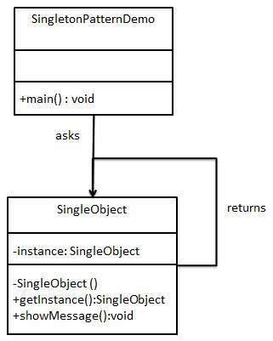

Slide 149
Step 1 Create a Singleton Class. SingleObject.java
public class SingleObject {
//create an object of SingleObject
private static SingleObject instance = new SingleObject();
//make the constructor private so that this class cannot be instantiated
private SingleObject(){}
//Get the only object available
public static SingleObject getInstance(){
return instance;
}
public void showMessage(){
System.out.println("Hello World!");
}
}

Slide 150
Step 2 Get the only object from the singleton class. SingletonPatternDemo.java
public class SingletonPatternDemo {
public static void main(String[] args)
{
//Get the only object available
SingleObject object = SingleObject.getInstance();
//show the message
object.showMessage();
}
}

Slide 151
Step 3
Verify the output.
Hello World!

